Slide 1
Presenter notes
Resources:
actions/cache
Docs: Caching dependencies to speed up workflows
Learning Lab: Publish packages with Actions
Docs: Packages
Open container image specs
GitHub Marketplace: build and push Docker images
Docs: Configuring Docker for use with GitHub Actions
Docs: Creating and storing encrypted secrets
Docs: Actions API
Blog: Delete and restore packages
Demo prep:
See managing secrets walkthrough document
FAQ:
FAQ slides at end
Customer stories:
N/A
Expected timing:

Slide 2
Manage builds, packages, and secrets
GitHub Bootcamp
@presenter name (optional)

Slide 3
This module will enable you to:
Discuss automation management strategies GitHub using builds, packages and secrets

Slide 4
Build management

Slide 5
Best practices related to caching
Self-hosted runners for specialized workloads
Build management features
Notes:
Already mentioned self-hosted runners for specific needs such as storage space or CPU
Recap on best practices
Don’t use self-hosted runners for public repos
Caching
There’s an option to cache dependencies to speed up your workflow; https://github.com/actions/cache
At scale, it could save you runner minutes in case of GitHub-hosted runners

Slide 6

Cache effectively
Optimize your workflow performance with caching:
5GB max cache size per repo
7 Days retention
Scoped to key and branch
Avoid caching sensitive data
Use caching for performance and artifacts to save files between job runs
Notes:
Caching can help with speeding up workflows when you need to install dependencies. NPM, Python, Ruby, etc… these are simple examples of applications that require dependencies to be built. But there are more complex scenarios, such as Java, C/C++ and modularized microservices that often require downstream artifacts. Caching can speed up your builds when your dependencies have not changed
Jobs on GitHub-hosted runners start in a clean virtual environment and must download dependencies each time, causing increased network utilization, longer runtime, and increased cost.
To help speed up the time it takes to recreate these files, GitHub can cache dependencies you frequently use in workflows.
********
Resources
https://docs.github.com/en/actions/guides/caching-dependencies-to-speed-up-workflows
********

Slide 7
Package management

Slide 8
Best practices
Limitations
GitHub packages
Notes:
********
Resources
https://lab.github.com/githubtraining/github-actions:-publish-to-github-packages
********

Slide 9
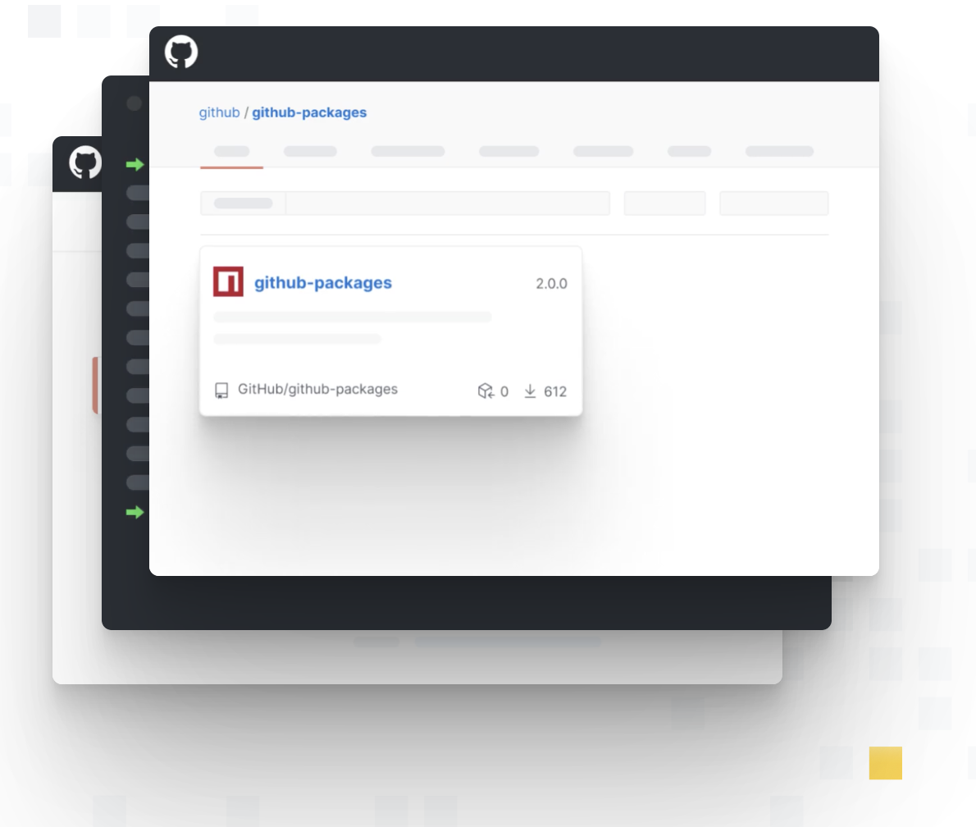
Centralized packages
Npm
Nuget
Maven
Gradle
RubyGems
Docker
Notes:
One place to rule them all https://docs.github.com/en/packages
********
Resources
https://github.blog/changelog/2021-02-17-packages-delete-and-restore-for-all-packages/
********

Slide 10
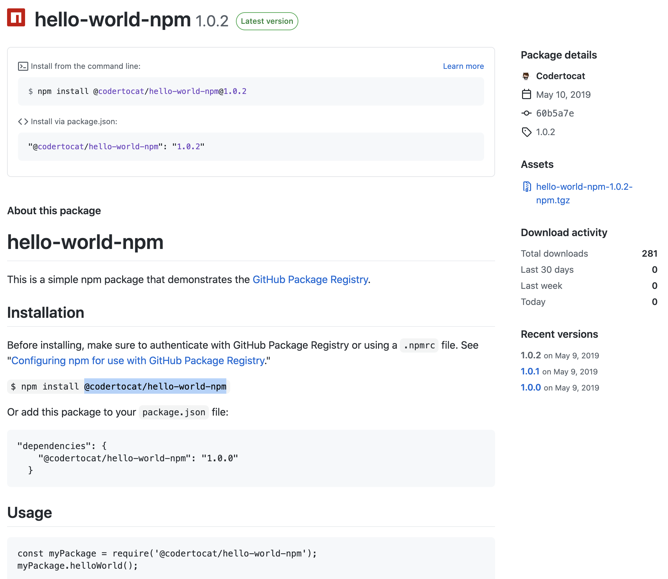
NPM
Publish from GitHub
Uses repository
GitHub adds metadata
Notes:
Publish directly from GitHub
Automatically uses README in your repository to generate package details.
GitHub adds metadata for each package that includes links to the author, repository, commit SHA, version tags, and date
Example using NPM
If you have a repo which is a node repo, you can publish that as a package
GitHub GUI allows you to inspect the package metadata similar to what you can do on e.g. npmjs.com

Slide 11
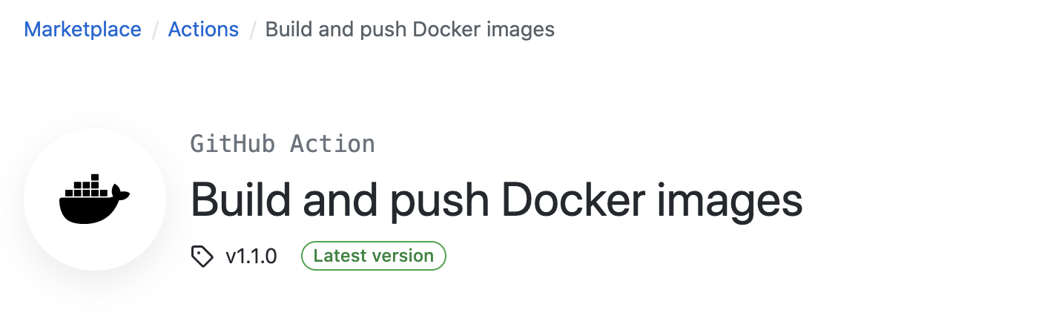
Docker
Publish directly from GitHub
OpenContainers support
Docker Action
Notes:
Can also publish to other container registries than DockerHub
Can be controlled via the config file of the action
Have a look at the Marketplace
********
Resources
https://github.com/opencontainers/image-spec/blob/master/annotations.md
https://github.com/marketplace/actions/build-and-push-docker-images
********

Slide 12
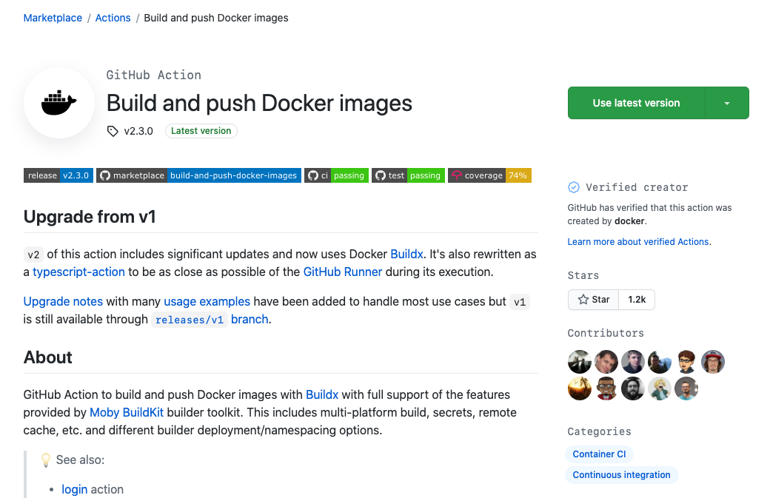
Publish to DockerHub
Use docker/build-push-action
Control target environment
https://github.com/marketplace/actions/build-and-push-docker-images
Notes:
Notice that this workflow is using an existing action from Docker
Here, you can control the target environment using variables and secrets
Optional - demo an Action that publishes to DockerHub
********
Resources
https://docs.github.com/en/packages/using-github-packages-with-your-projects-ecosystem/configuring-docker-for-use-with-github-packages
********

Slide 13
Packages vs GitHub Container Registry
Packages
GHCR
Software package hosting service
Host software packages privately or publicly
Use packages as dependencies
Designed to support the unique needs of container images
Host and manage Docker container images in your organization or personal user account
Fine-grained permissions for access management
Visibility separate from repository visibility
Notes:
Secrets can only be managed by people with admin or owner access.
When to use org secrets vs repository secrets
Demo, show where secrets are added at the org and repo levels

Slide 14
Questions
Notes:
The following questions are for presenter knowledge, not a script; we recommend to take live questions.
Common questions
Q: Can the package registry be used as a generic artifact storage? For example, can I just upload my web-site build as a zip package there? Is there an advantage/disadvantage to keeping the image in GitHub registry vs ACR?
A: I think no, realistically. Maybe some kind of performance thing if it was in GitHub's registry and then you're using it in GitHub, or vice versa with an ACR image.
Q: Ok, i was thinking as containers die and/or scale. If I'm running an Azure WebApp for containers. With ACR, its all in Azure so might be more responsive instead of having to roundtrip to Github's datacenter.
A: Advantage of using the GitHub Registry are all in one place. Disadvantage is round-trip time if you need to scale or update. That’s pretty much the gist of it though

Slide 15
Secrets management

Slide 16
GitHub Secrets
GITHUB_TOKEN
secrets.<NAME>
CLI management
Limitations
API
Notes:
You can add specific secret information at the repository or org level, which can be referenced by a key value. The secret is encrypted.
GITHUB_TOKEN is a secret specific to actions. GITHUB_SECRETS is an example of an automatically available secret. You can manage secrets using the CLI.
We'll talk about how to add them, the limitations, and their accessibility through the API.
Let's talk a bit more in detail.

Slide 17

Secrets
Organization
Repository
Allows secret management at org level without duplication
Effectively becomes repository secrets
Can be scoped to specific repositories
Not available with the free plan
Secrets
Scoped to a repository
Can be used to override Org secrets
Available on free plan
Notes:
Secrets can only be managed by people with admin or owner access.
When to use org secrets vs repository secrets
Demo, show where secrets are added at the org and repo levels

Slide 18


Secrets
Environment Secrets
Secrets
Organization Secrets
Repository Secrets
Environment Secrets
Apply to a specific environment
Override Org / Repo secrets
Only Users with environment permission can add / edit
Notes:
These secrets apply to a specific environment. They override org and repo secrets. Only users that have specific permission to to that environment can add and edit a secret.
The diagram shows the hierarchy in which the system checks for secrets.
Organization secrets are at the highest level. Then there are repository secrets with environment secrets below. Whenever I actions run, the system first checks if the secret is present in the environment. If there is no secret with that name in the environment, it falls back to the repository level check. If you there are no repository level secrets present, the system falls back to organization secrets. If there is no secret available at the organization level, the action will fail.

Slide 19
Secrets limitations
Secrets cannot be read in apps
Actions API does not provide a resource to the encrypted value
By default, secrets are not passed to workflows triggered by forked repos. For private repos, you can enable these.
Workflow could have up to 100 secrets
Secrets are limited to 64K
Use `gpg` to encrypt larger secrets on the repository
Notes:
********
Resources
https://docs.github.com/en/actions/configuring-and-managing-workflows/creating-and-storing-encrypted-secrets#limits-for-secrets
********

Slide 20

DEMO

Slide 21

GitHub Actions API
Endpoints available to view anything from the Actions UI
Artifacts, workflows, job information, run information
Secrets API to manage and update your secret stores
Notes:
With the Actions API, you can do a lot of the things that you can do with the UI.
Examples:
View information about build artifacts
Workflows - Ex. Checkout the run execution time.
See the status of workflows and find out the success rates
The secrets API allows you to manage repository and organization secrets. Use it to do things like roll tokens automatically. For example, by having a script that generates a new token for your external API service, you can add the token to your repository just by updating the existing secret.
********
Resources
API Documentation: https://docs.github.com/en/rest/reference/actions
********

Slide 22
Questions

